Slide 1
Spark Dataset
Pravin Y Pawar

Slide 2
Spark SQL - Dataset
Dataset is a data structure in SparkSQL which is strongly typed and is a map to a relational schema
Represents structured queries with encoders
Is an extension to data frame API
Provides both type safety and object-oriented programming interface
Clubs the features of RDD and DataFrame
Provides the convenience of RDD
Gives performance optimization of DataFrame
Static type-safety of Scala
Provides a more functional programming interface to work with structured data

Slide 3
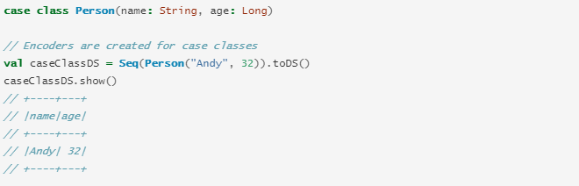
Creating Datasets
Datasets are similar to RDDs, however, instead of using Java serialization or Kryo they use a specialized Encoder to serialize the objects for processing or transmitting over the network

Slide 4
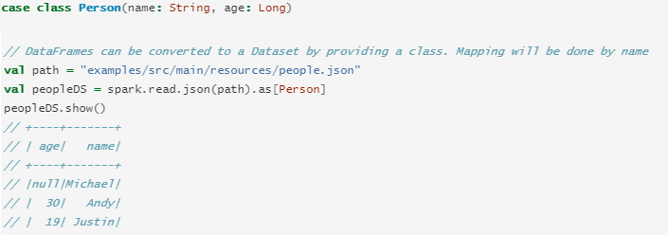
DataFrame to Dataset
Example

Slide 5
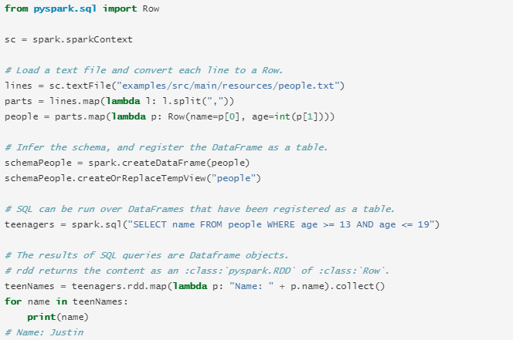
Interoperating with RDDs
Inferring the Schema Using Reflection
Method uses reflection to infer the schema of an RDD that contains specific types of objects
Reflection-based approach leads to more concise code and works well when you already know the schema while writing your Spark application.

Slide 6
Thank You!
Reference :
Spark Documentation
In our next session: Comparing RDD / DataFrame / Datasets

